Slide 1
The rights of indigenous peoples and THEIR influence On the history of Greenland
NAAPITTA september 1st 2023

Slide 2
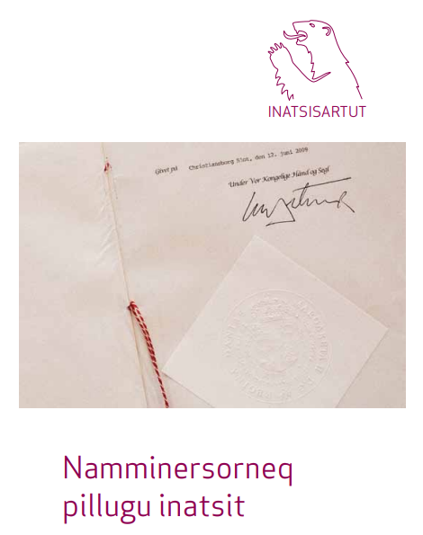
”a people pursuant to international law”
The preamble to the Self-Governing Act emphasizes Greenland's development from a Danish colony to the self-governing country it is today

Slide 3
”a people pursuant to international law”
” Recognising that the people of Greenland is a people pursuant to international law with the right of self-determination, the Act is based on a wish to foster equality and mutual respect in the partnership between Denmark and Greenland. Accordingly, the Act is based on an agreement between Naalakkersuisut [Greenland Government] and the Danish Government as equal partners.”

Slide 4
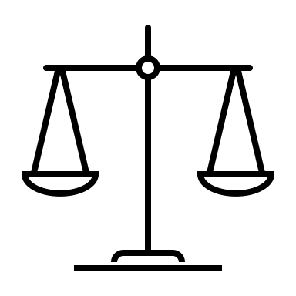
Self-determination
Self-determination denotes the legal right of people to decide their own destiny in the international order.
Self-determination is a core principle of international law, arising from customary international law, but also recognized as a general principle of law, and enshrined in a number of international treaties.

Slide 5
The post-WaR period
In the time before and after the UN's intervention, there is great dissatisfaction with the relationship between Denmark and Greenland and the treatment of kalaallit.
After the Second World War, the censorship of the critical voices from Greenland was reduced

Slide 6
The post-WaR period
In the 1950’s, people began to discuss a cultural development in the entire Inuit area, a so-called "pan-Eskimoism"
Nikolaj Rosing said the following to the Folketing on May 20th 1959:
"The construction of Greenland has been, and still is, a gain for many Danish homes in terms of employment."

Slide 7
A very short historical overview
Timeline of historical events regarding Greenlanders' awareness of their rights, including the rights of Indigenous Peoples
Greenland wants to be a part of Denmark – not just a colony | “The negotiators from Greenland are treated as colonial people” | Greenland is included in the kingdom as a county of Denmark | Greenland and the EC | The International Arctic Peoples Conference | Inuit Circumpolar Conference | Greenland gets Home Rule. | Greenland achieves Self-Government
14.04.1949 | 04.08.1949 | 05.06.1953 | 01.01.1973 | 22.-25.11.1973 | Juni 1977 | 21.02.1979 | 21. Juni 2009
Nicolai Rossing, member of the provincial council: "The child is growing up" wanted to have the same status as the rest of Denmark. | In “Land og Folk” There is a lot of discontentment amongst the Greenlanders. . | Greenland obtains representation in the Folketing. Denmark considers its UN obligations to have ceased. | Greenland votes No in November 1972, but is forced to join by Denmark, dissatisfaction grows. | The first major meeting organized for and by Indigenous Peoples, where the first steps for rights work in the Arctic were initiated. | The very first ICC conference was held in Barrow, Alaska. | The home rule scheme was adopted after an indicative referendum on 1 May 1979 had a majority of 70.1% in favor of the proposal. | Greenland achieves Self-Government, with a preamble which makes it impossible for Denmark to take back the decision.
Notes:
Inuit Circumpolar Conference juni 1977 Nunatsinniit aallartitatut peqataapput:
Ark'alo Abelsen, Ivalu Egede, Malik Høegh, Karl Isaksen, Stina Jakobsen, Jonas Jeremiassen, Karl Lennert, Hans Lynge, Niels H. Lynge, Christian Nielsen, Carl Christian Olsen, Karl Elias Olsen, Moses Olsen, Ove Rosing Olsen, Dr. Robert Petersen, Kristian Poulsen, David Qavigaq, Hans-Pavia Rosing.

Slide 8
sumé
Notes:
Men hvad skete der i perioden mellem 50’erne og 70’erne som forklarer denne politiske opvågning i Grønland?
Denne korte trailer til filmen ”Sumé – Lyden af en revolution” kommer med en meget fin opsummering.

Slide 9
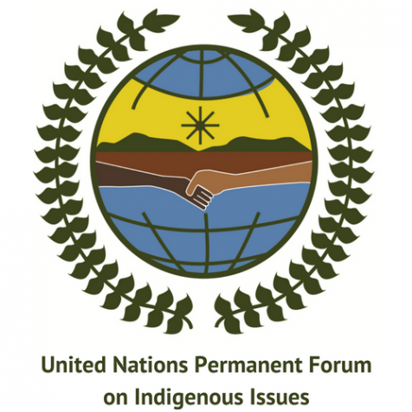
Greenland's influence locally and internationally
Greenland has a voice in both the Nordic Council and the Arctic Council.
Tove Søvndahl Gant sits on behalf of Greenland in the UN's Permanent Forum on Indigenous Peoples' Affairs.

Slide 10
Greenland's influence locally and internationally
We have various represenatations in the world:
Our representation to the EU in Brussels 🇪🇺
Washington D.C. 🇺🇲
Copenhagen 🇩🇰
Reykjavik 🇮🇸
Beijing 🇨🇳
where we work for Greenland's interests.

Slide 11
Greenland's influence locally and internationally
Greenland has laid a neutral basis for the Ilulissat declaration between Russia, the USA, Canada, Norway and Denmark/Greenland, about a.o. to maintain the Arctic as a low-tension area and to prioritise the Arctic environment.

Slide 12
But did you know…?
That the proposal for the UN's Permanent Forum for Indigenous Peoples' Affairs came from a Greenlander?

Slide 13
But did you know…?
That ILO169 on Indigenous Peoples and Tribal Peoples in Independent States was co-authored by a Greenlander?

Slide 14
But did you know…?
That a Greenlander has helped establish ministerial ILO committees in South Africa and Cambodia?

Slide 15
But did you know…?
That two Greenlanders helped write the "Global Earth Charter movement" - a global environmental manifesto?

Slide 16
Henriette rasmussen
It was Henriette who was mentioned in the previous slide.

Slide 17
Henriette rasmussen
She was a representative of a new awareness of women in Greenland, who came to stand in sharp opposition to Arnat Peqatigiit Kattuffiat,

Slide 18
Henriette rasmussen
With her, a woman was no longer just a housewife, she could be a researcher, a politician, a businesswoman now.

Slide 19
Henriette rasmussen
She was the first female IA politician in Nuuk's municipal council

Slide 20
Henriette rasmussen
She ensured that the UN Convention on the Rights of the Child was acceded to by Greenland in 1992.

Slide 21
ICC Greenland’s inFluence
The ICC's importance to Greenland's political history is undeniable.
Greenland's political history and the history of the ICC in the late 70s and early 80s are woven together to such an extent that it can be difficult to separate the two.

Slide 22
ICC Greenland’s inFluence
ICC's global work for indigenous people has, a.o., led to
The ICC's participation in the Arctic Council, where the ICC is both a founder and has the status of a permanent participant in the meetings, as well as,
The ICC's consultative status in the UN's Economic and Social Council ECOSOC.

Slide 23
ICC Greenland’s inFluence
The ICC has also been decisive for the realization of the UN Declaration on the Rights of Indigenous Peoples.
The ICC is to this day a leading voice in international for a when it comes to Indigenous Peoples’ Rights, and environmental and climate change discussions.

Slide 24
Greenland’s influence
Greenland has had an enormous influence on the world community, to a degree that we ourselves don’t even know.
From conventions, forums, declarations, agreements and rights – Greenland has helped to lead the way in human rights, Indigenous Peoples’ rights, environmental and climate change mitigation work.

Slide 25
Decolonizing our history
We are rewriting and decolonizing our history.
All of which creates a greater sense of pride, identity and self-worth.

Slide 26
Yet, there are challenges
In order to get into gymnasium (high school) and university it is a must to be able to speak Danish as all material and must lecturers are Danish.
As such, last year was the first time that we ever had university exams in Greenlandic in our department.
This structure and hierarchy the language barrier creates has for many years ensured an invisible wall between university educated Greenlanders and the rest of the population as they have often been considered to have become "Danified".

Slide 27
Challenges
The lack of Greenlandic terminology on Indigenous Peoples’ rights, human rights, decolonization and colonization has led to a stagnant discussion where only the "Danified" Greenlanders would have access to the discussion.

Slide 28
Challenges
This has led to Danish speaking elite who would attempt to speak on behalf of all the Greenlandic people, and when other Greenlanders who aren't fluent in Danish would question their statement(s), they would get accused of being too colonized to be able to have a valid position in the discussion.

Slide 29
Lateral violence
The frustration of the two opposing poles have led to a nickname of "Decolonizeikkut" the "decolonize people".
They have been put in a box of "social media warriors" by many of the Greenlandic citizens as many do not consider “just” speaking about decolonization as decolonization - even though it is and can be!

Slide 30
The Human Rights Landscape in Greenland
Human rights institutions and councils established in Greenland
1998 Gender Equality Council
2012 MIO – National Child Rights Institution, and the Spokesperson for Children’s Rights
2013 Human Rights Council of Greenland
2017 Spokesperson for Persons with Disabilities, also with a national Institution
2019 Spokesperson for Elderly people

Slide 31
The Human Rights Landscape in Greenland
Secure the inclusion of fundamental human rights principles in lawmaking.
Actively take part in securing Indigenous Peoples’ economic, social, cultural, linguistic and political survival, and continue to work for the implementation of the UNDRIP in the Arctic and Globally.
Strengthen and use the expertise within IP’s rights in the international work.

Slide 32
Focus points at the moment
Involuntary IUD´s call for a thorough investigation
Woman with multiple disabilities abused at residential care institution
The right to one´s own body (consent-based rape provision in the Criminal Code)
The right to Identity and Nationality
Workshops with our dialogue cards
Hearings from Naalakkersuisut

Slide 33
focus points at the moment
Recommendations regarding abuse at residential institutions
Explainer video about the United Nations Guiding Principles on Business and Human Rights
Report on Fair Trial processes
Report on the right to a healthy environment
Focus on discrimination in general and especially regarding LGBTQ+ persons in Greenland

Slide 34
Qujanaq Thank you
Qivioq Løvstrøm, Chair, Greenland Human Rights Council
For further information please contact info@humanrights.gl

